Slide 1

IT Governance
Information Systems Auditing
Class I

Slide 2
Getting To Know
Who am I?
Who are you?
What is this class about?
The Basic Concept of IT Governance

Slide 3
Getting To Know

Slide 4

Teuku Raja Irfan Radarma
Unit Kerja: Inspektorat Jenderal Kemenkeu
Email: teuku.radarma@kemenkeu.go.id
Telepon/WA: +62 89652063776
2013
Inspektorat Jenderal
Kemenkeu
XXXX
Lahir, Tangerang
2023
S2 Carnegie Mellon University
2012
DIII STAN
2017
S1 Universitas Andalas

Slide 5
Now, Who Are you?

Slide 6
Class Overview
General path of where this class is going this semester

Slide 7
Class Roadmap
IT Governance: Concept
IT Governance: Audit Program
IS Acquisition, Development & Implementation I
IS Acquisition, Development & Implementation II
IS Operation & Business Resilience
Protection of Information Assets I
Protection of Information Assets II
Mid-Term Exam
Basic of Data Analysis
Risk and Control
Parallel Simulation
Analytics and Sampling
Substantive Testing: Sales Cycle
Substantive Testing: Expenditure Cycle
Audit Report
Final Exam

Slide 8

Aktivitas Kelas
Setiap slide merah seperti ini berarti saya mengharapkan partisipasi teman-teman semua.
Silakan gunakan sumber apapun untuk berpartisipasi, termasuk google, buku, ChatGPT, dll.

Slide 9
Class Logistic
Slides, data, and other logistics for this class can be accessed through:
Irfanradarma.github.io/Audit-SI
LMS
Quick and updated
Delayed and not updated

Slide 10
Do’s
Be on time!
Use AI RESPONSIBLY

Slide 11
Don’t
Lie

Slide 12
IT Governance: Concept
#direction #control #accountability

Slide 13
What is the difference between Information Technology (IT) and Information System (IS)?

Slide 14
Information System & Information Technology
People
Information System is a system that combines technology, people, and processes to collect, process, and deliver information for decision-making.
Information Technology is the technology — hardware, software, and networks — used to store, process, and transmit data.
Information System
Process
Technology (Information Technology)

Slide 15
What is Governance?

Slide 16
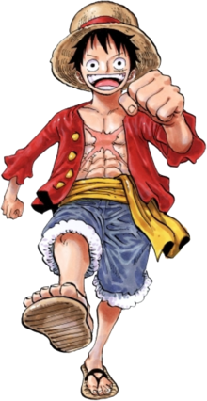
Luffy wants to find One Piece and become the Pirate King
But wanting it isn’t enough
The Grand Line is dangerous, unpredictable, and full of risks
Then he invites the best crews he can get
Is that enough to make sure he can overcome all challenge to achieve the goal? Nope!
He must be a leader who governs:
Set a clear goal for everyone
Distribute roles and responsibilities (who does what on the ship)
Make decision when there’s conflict
Maintain trust discipline among the crew
Adapt to risks and change in the Grand Line
goal
That is governance!
not fighting the battles yourself, but ensuring everyone and everything works together toward the same goal.

Slide 17


Governance
“Governance is the system by which organizations are directed and controlled to achieve objectives, manage risks, and use resources responsibly.”
Governance is about how things are directed and controlled.
It ensures everyone follows the same rules, works toward the same goals, and is accountable for results
Governance is about direction, control, and accountability.

Slide 18
Governance Is About Decision Rights
Governance defines:
Who makes decisions
How those decisions are made
What information is needed to make them
Who is accountable for the outcomes
In any organization, governance ensures the right people make the right decisions with the right information, at the right time.

Slide 19
Governance Exists Because Control Is Needed Without Constant Supervision
In any organization, leaders can’t personally oversee every action.
Governance creates a system of delegation and oversight — so the organization runs properly even when the top leaders aren’t watching every move.
It’s built on:
Structures (like boards, committees, and policies)
Processes (like planning, monitoring, and reporting)
Values and Principles (like fairness, transparency, and responsibility)
Governance is both formal (rules, frameworks) and cultural (values, tone at the top).

Slide 20
Governance Is About Balancing Interests
Organizations exist in a web of stakeholders — owners, employees, regulators, customers, society.
Governance ensures that decisions serve the organization’s purpose without unfairly favoring one group.
It’s not just about doing things right, but doing the right things, the right way, for the right reasons

Slide 21
Speaking About Balancing Interest
That’s the core of IT Governance!
balancing different interests, priorities, and risks to reach a common goal.

Slide 22
IT Governance
“IT Governance ensures that IT supports and extends the organization’s strategies and objectives.” It focuses on value delivery, risk management, performance measurement, and resource optimization.
IT Governance is about how technology decisions and activities are guided and monitored so that IT supports the organization’s goals.
IT Governance = making sure IT does the right things, the right way, for the right reasons.

Slide 23
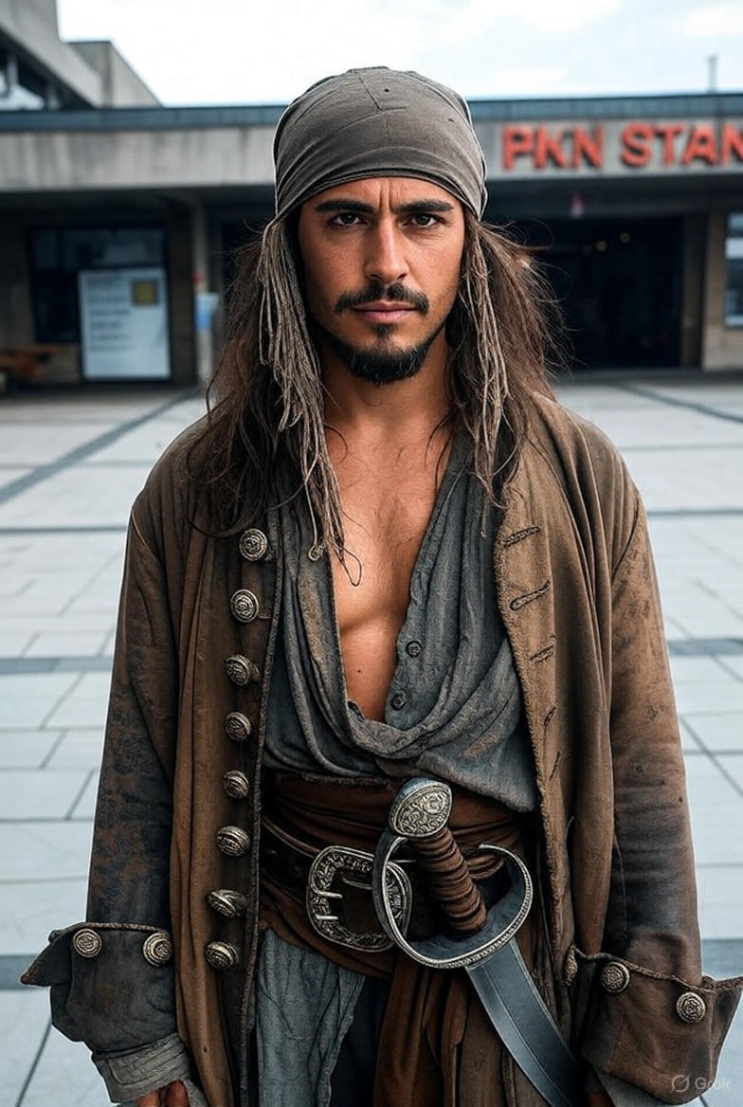
Suppose You are A Pirate Now
Now, the ship has a powerful engine room — that’s your IT function.
The engineers maintain the engines, patch systems, and keep everything running — that’s IT operations.
But who decides:
What kind of engine the ship should use?
How much fuel to spend?
Which route is the safest or fastest?
That’s IT Governance — the guiding compass that ensures technology supports the ship’s journey, not distracts from it.

Slide 24
IT Governance Is About Decision Rights in IT
It defines:
Who makes IT decisions (CIO, business unit, board, etc.)
How IT priorities are set
How resources are allocated
How performance and risks are monitored

Slide 25
Why IT Governance Exists
Technology now drives nearly every business process: more complexity, more risk, and more cost.
Leaders can’t oversee every system or project directly, so IT Governance provides a framework of structures, processes, and accountability — ensuring IT investments are controlled, justified, and aligned.
It turns IT from a cost center into a strategic enabler.

Slide 26
Governance vs Management
#alignment

Slide 27
Governance vs Management
Governance and management are closely connected, but they are not the same thing.
At its core:
Governance is about direction, control, and accountability.
Management is about execution, coordination, and performance.
Governance decides what should be done and why.
Management decides how it should be done and makes it happen.

Slide 28
⚓ The Ship Analogy
Imagine again our ship on the Grand Line.
The Captain decides
where the ship is going
why that’s the goal
what rules everyone follows
The Crew:
adjusts the sails
keeps the engine running
navigates through storms
Governance
MANAGEMENT

Slide 29
How They Work Together
Governance and management are complementary, not hierarchical.
Governance provides the framework — vision, boundaries, and accountability.
Management provides the action — turning governance decisions into results.
Governance says “We will go north.”
Management figures out “How do we get there safely, efficiently, and on time?”

Slide 30

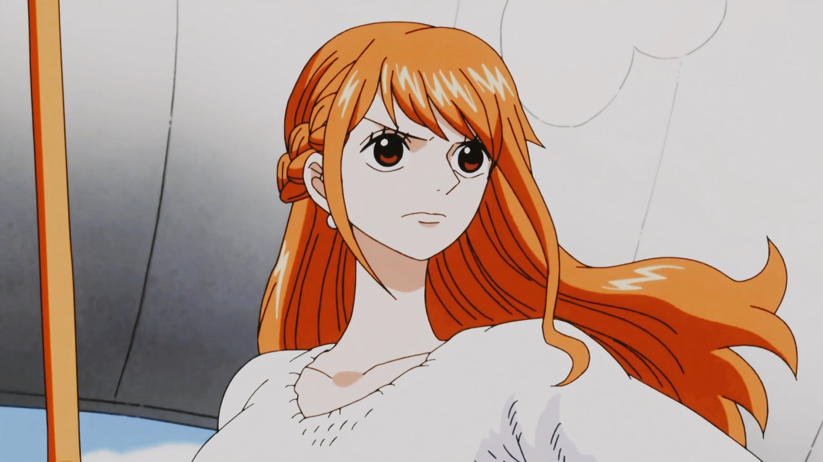
How They Work Together
“We will go north.”
“How do we get there safely, efficiently, and on time?”

Slide 31
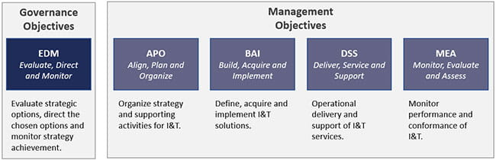
COBIT IT Governance and Management Framework

Slide 32
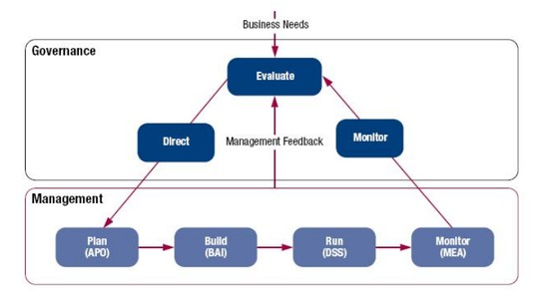
COBIT IT Governance and Management Framework

Slide 33
Assignment I – Audit The Lecturer
Objective: To practice the fundamental auditor’s mindset (gathering evidence, verifying facts, and forming conclusions.)
You will apply investigative skills to construct a factual profile of me using publicly available sources and ethical methods.
It is individual assignment!
You may use:
Internet searches (articles, publications, social media, official websites, etc.)
Digital footprints (academic or professional records, conference mentions, etc.)
Publicly available documents, videos, or interviews

Slide 34
Assignment I – Audit The Lecturer
Your task is to:
Collect as many relevant data points as you can find.
Evaluate the reliability and credibility of each source.
Summarize your findings into a concise factual profile.
Conclude what you can infer about my background, expertise, and interests based only on the evidence gathered. (extra points for those gathered unique and rare findings)
Rules & Ethics
Use only open-source and publicly available information.
No direct messaging, hacking, or intrusive actions.
All claims must be supported by traceable evidence (e.g., link, citation, screenshot).
Maintain a professional and respectful tone in your report.

Slide 35
Deliverable
Format: Short report (1–2 pages) or slide deck (max 5 slides)
Content:
Summary of findings
Evidence list
Deadline: November 16th @ 23.59 WIB
Submission: https://forms.gle/x6iMiFd9QNPsjCE16

Slide 36
Serba-Serbi

Slide 37
Governance in One Piece World
Governance Element | One Piece Example | Explanation
Vision / Goal | Find the One Piece and make Luffy the Pirate King | Every organization needs a clear purpose and direction.
Governing Body | Luffy (Captain) and core crew leaders (Zoro, Nami, Robin) | They set direction, make decisions, and ensure everyone stays aligned.
Structure & Roles | Each crew member has a defined role — navigator (Nami), cook (Sanji), doctor (Chopper), etc. | Governance defines who does what — clear roles and responsibilities.
Rules & Culture | Crew’s code of loyalty, respect, and freedom | Governance creates the values and rules that guide behavior.
Accountability & Oversight | Luffy trusts his crew but steps in when something goes wrong | Governance is about trust with accountability, not micromanagement.
Risk & Change Management | Adapting to new seas, Marines, or enemies | Governance ensures the crew anticipates risks and adapts responsibly.

